Slide 1
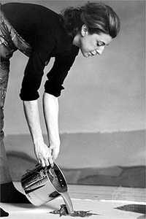
Helen Frankenthaler
Born in 1928 in New York City.
In 1952 twenty-four-year old Helen Frankenthaler made history in the New York art world when she developed her soak-stain technique.
Extending Jackson Pollock's method of applying paint to unprimed canvases on the floor, she thinned her oils with turpentine and allowed the pigments to soak directly into the canvas.

Slide 2
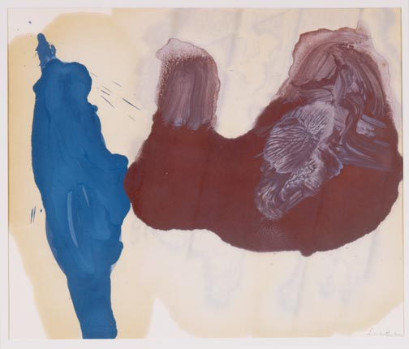
Helen Frankenthaler American, born 1928
Untitled, 1963 Acrylic on paper

Slide 3
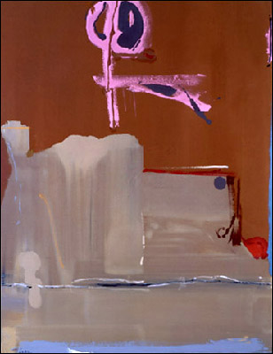
Helen Frankenthaler Captain's Watch
1986 Acrylic on canvas

Slide 4
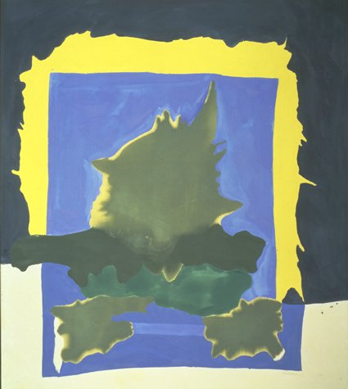
Helen Frankenthaler
Interior Landscape
1964
Painting
Acrylic on canvas

Slide 5
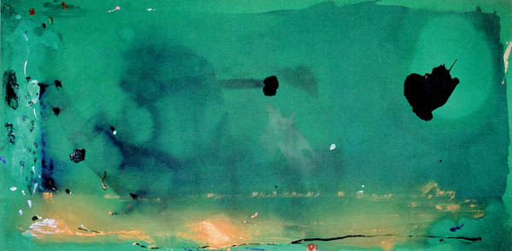
Helen Frankenthaler
Madame Matisse
1983
Acrylic on canvas

Slide 6
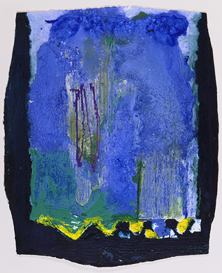
Helen Frankenthaler Freefall
1992

Slide 7
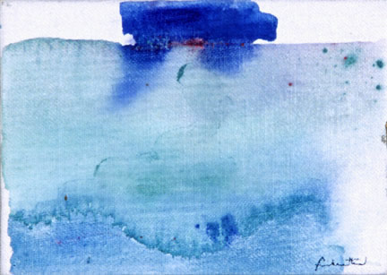
Helen Frankenthaler
(American, b. 1928) Untitled, 1982 Acrylic on canvas board

Slide 8
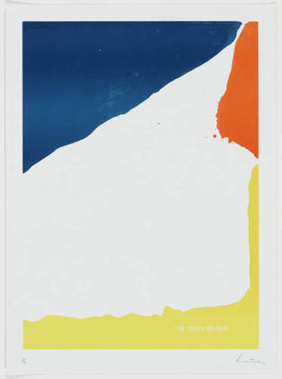
Paris Review
Helen Frankenthaler
(American, born 1928)
1967
Lithograph

Slide 9
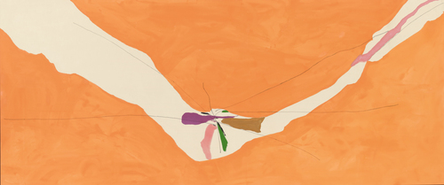
Chairman of the Board
Helen Frankenthaler
(American, born 1928)
1971
Synthetic polymer paint on canvas

Slide 10
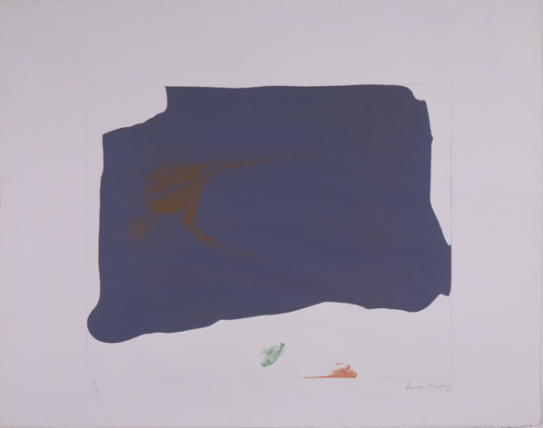
Helen Frankenthaler
(American, b. 1928) Variation II on Mauve Corner
1969 Lithograph

Slide 11
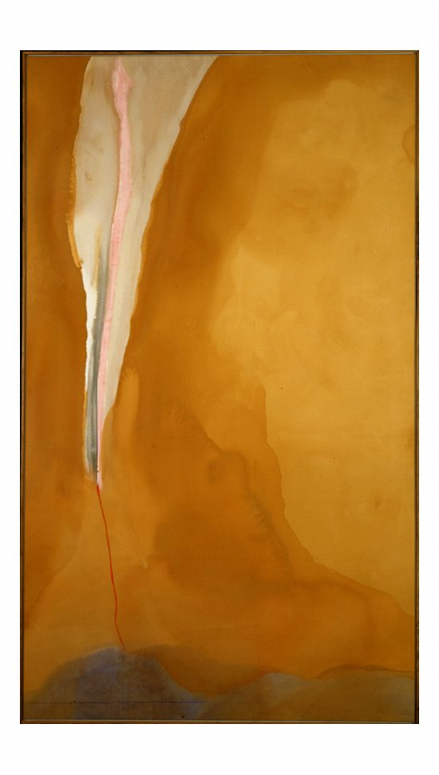
Coral Wedge 1972
Acrylic paint on canvas

Slide 12
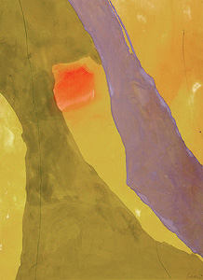
Helen Frankenthaler
(American, b. 1928) Pistachio
1971 Acrylic on unsized canvas

Slide 13
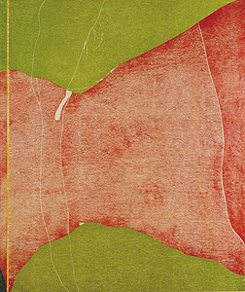
Helen Frankenthaler
(American, b. 1928) Savage Breeze
1974

Slide 14
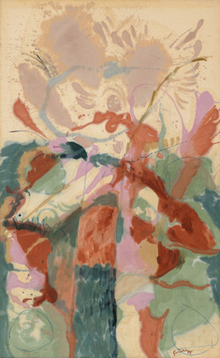
Jacob's Ladder
Helen Frankenthaler
(American, born 1928)
1957
Oil on unprimed canvas

Slide 15
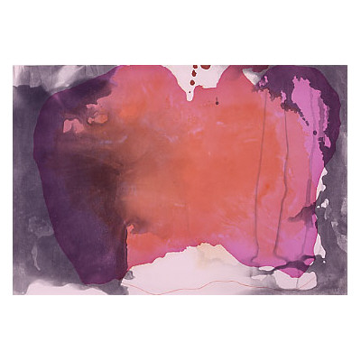
Causeway 2001

